Slide 1
Analysis pipeline development
Feb 14th, 2025

Slide 2
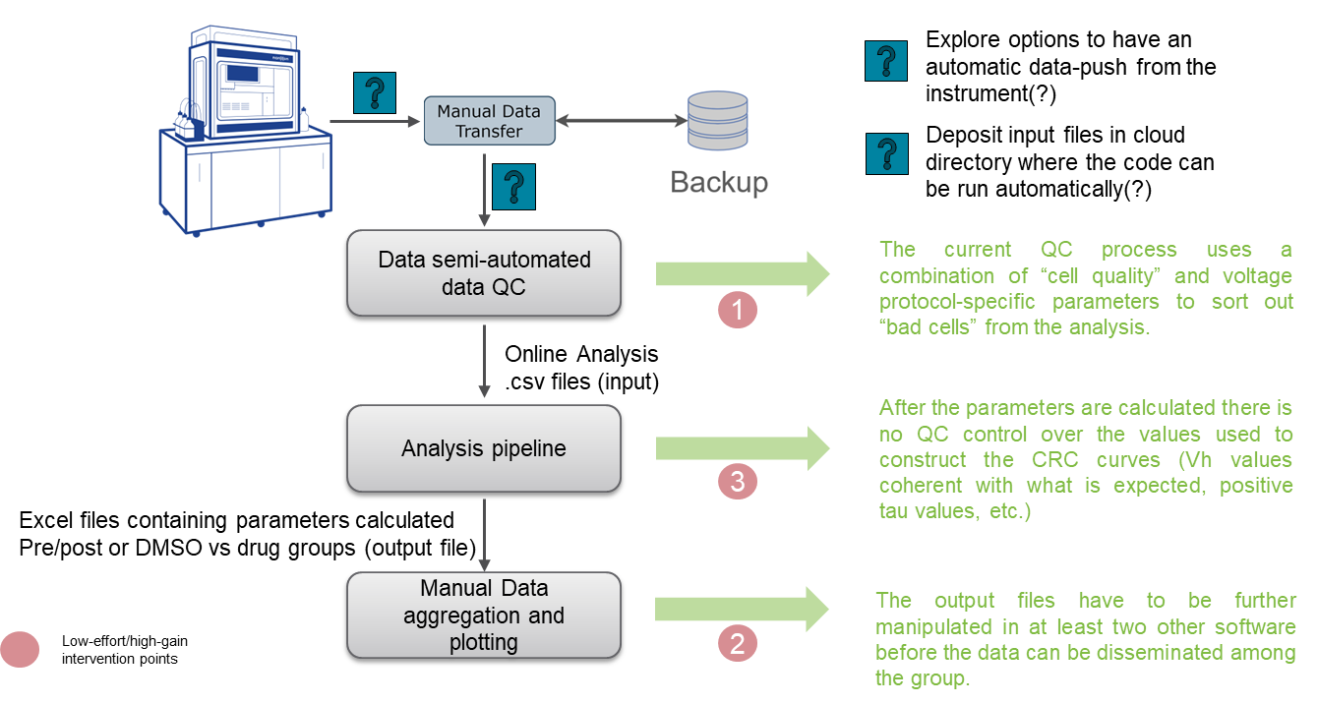
Analysis pipeline development
The current analysis pipeline

Slide 3
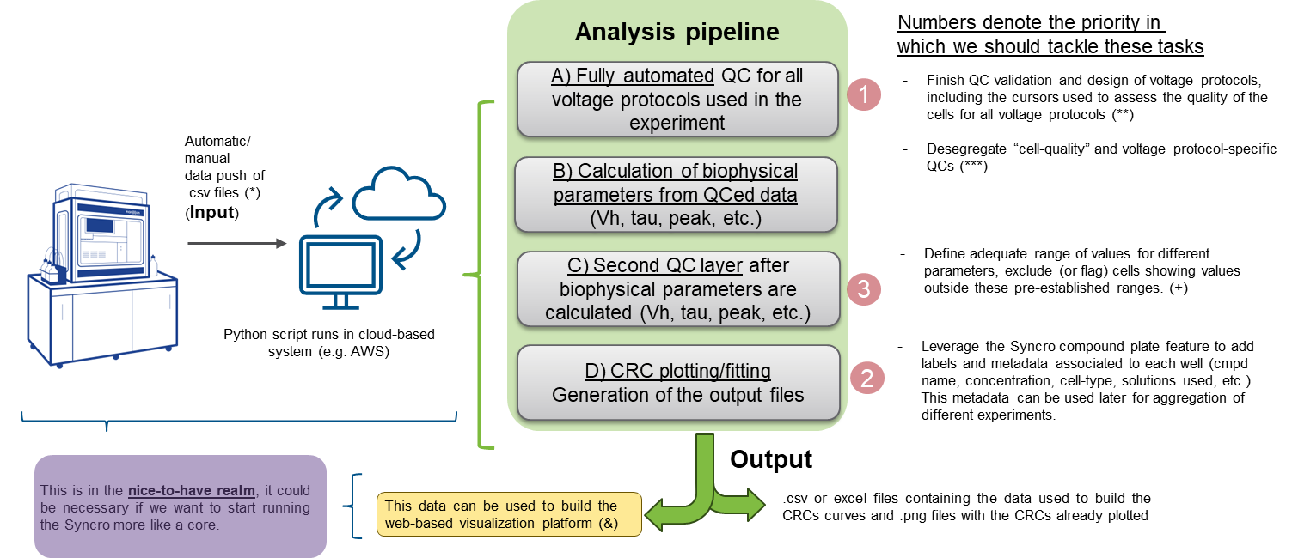
Suggested changes
(*) Run a small script where the .csv files at the end of the day can be synced from a folder into a cloud for analysis (google code lab (?))
(**) Pre-established convention of cursor naming and parameters exported in the OA file for all the voltage protocols (e.g. “leak prep” and “leak steady” cursors)
(***) The QC system in use for the “Cav3 IV holding” voltage protocol won’t change. This only applied to other voltage protocols (tau, recovery, and potential new voltage protocols).
(+) Example: Vh-ACT between -90 and 0 mV, recovery from inactivation ratio “n” < ration “n+1”, etc.
.

Slide 4
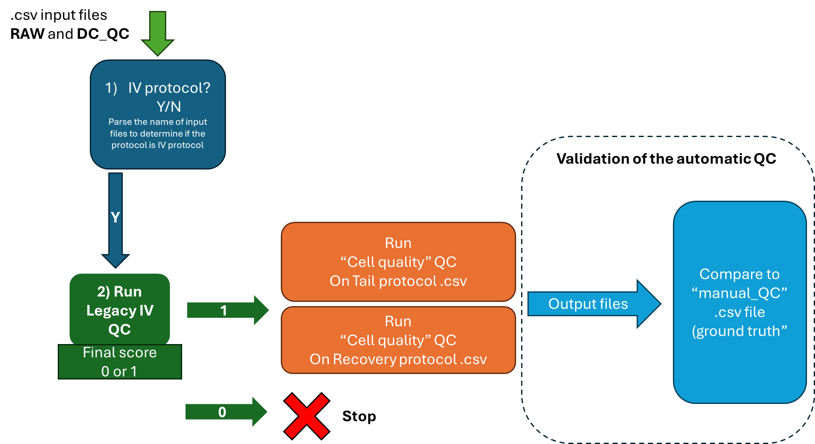
Quality Control Process and QC validation strategy
If a particular experiment does not have an “IV” file, we could still use the pipeline to QC and calculate parameters.
N
“Legacy IV QC” was developed and validated previously by Sean and Yining. We will leverage this as a building block for other voltage protocols’ auto-QC process
“RAW” files are .csv OA exported files (one for each one of the voltage protocols run in the example experiment) where all wells have been assigned a “T” in the “valid QC” column.
Using different metrics, the automatic QC script should be able to correctly assign “T” and “F” with respect to the manually QCed training data.

Slide 5

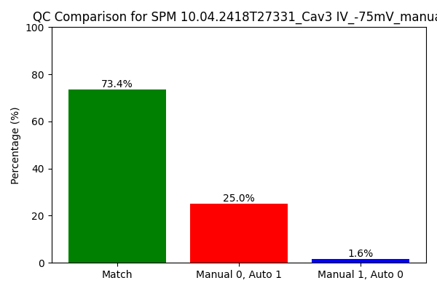
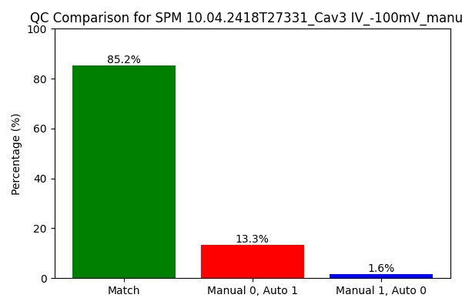
Automatic QC validation
Finish QC validation and design of voltage protocols, including the cursors used to assess the quality of the cells for all voltage protocols (**)
Desegregate “cell-quality” and voltage protocol-specific QCs (***)
“IV” protocol at -75 mV
“IV” protocol at -100 mV
Percentage of wells correctly assigned by the auto QC script compared with the manual QC process (either valid or invalid).
Percentage of wells incorrectly assign as valid by the auto QC process
Percentage of wells incorrectly assign as not valid by the auto QC process
Auto QC performance for “IV” files with respect to manually QCed data

Slide 6
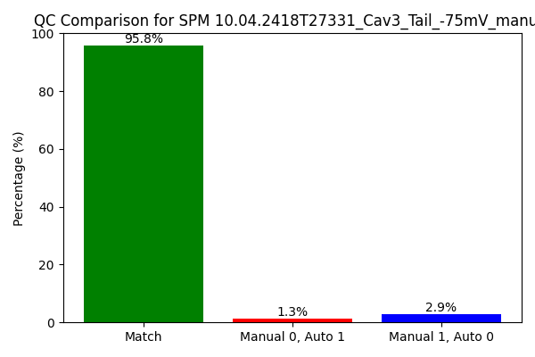
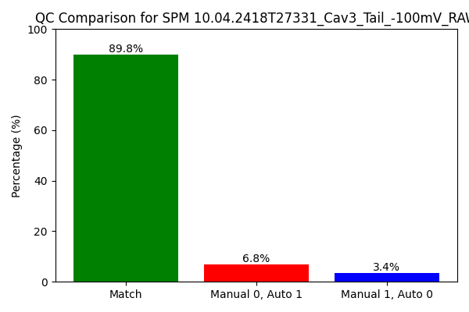
Automatic QC validation
Finish QC validation and design of voltage protocols, including the cursors used to assess the quality of the cells for all voltage protocols (**)
Desegregate “cell-quality” and voltage protocol-specific QCs (***)
“Tail” protocol at -75 mV
“Tail” protocol at -100 mV
Percentage of wells correctly assigned by the auto QC script compared with the manual QC process (either valid or invalid).
Percentage of wells incorrectly assign as valid by the auto QC process
Percentage of wells incorrectly assign as not valid by the auto QC process
Auto QC (based on cell quality properties) performance for “tail” files with respect to manually QCed data

Slide 7
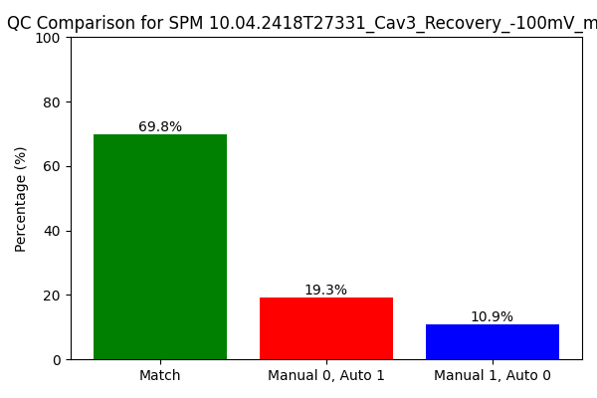
Automatic QC validation
Finish QC validation and design of voltage protocols, including the cursors used to assess the quality of the cells for all voltage protocols (**)
Desegregate “cell-quality” and voltage protocol-specific QCs (***)
“Recovery” protocol
Percentage of wells correctly assigned by the auto QC script compared with the manual QC process (either valid or invalid).
Percentage of wells incorrectly assign as valid by the auto QC process
Percentage of wells incorrectly assign as not valid by the auto QC process
Auto QC (based on cell quality properties) performance for “recovery” file with respect to manually QCed data

Slide 8
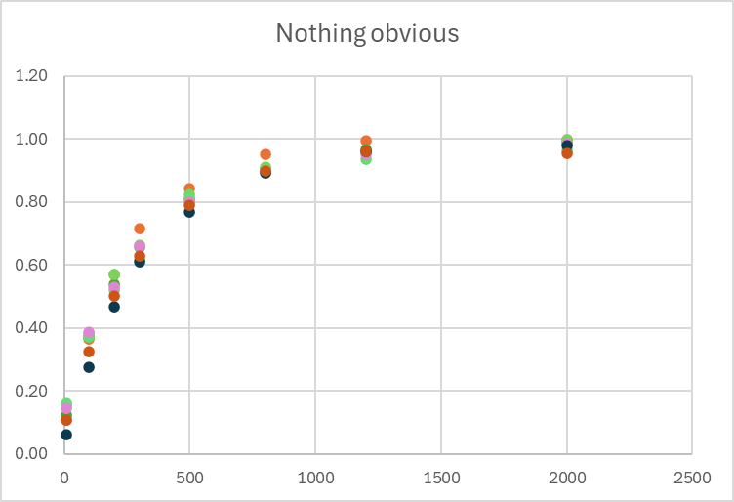
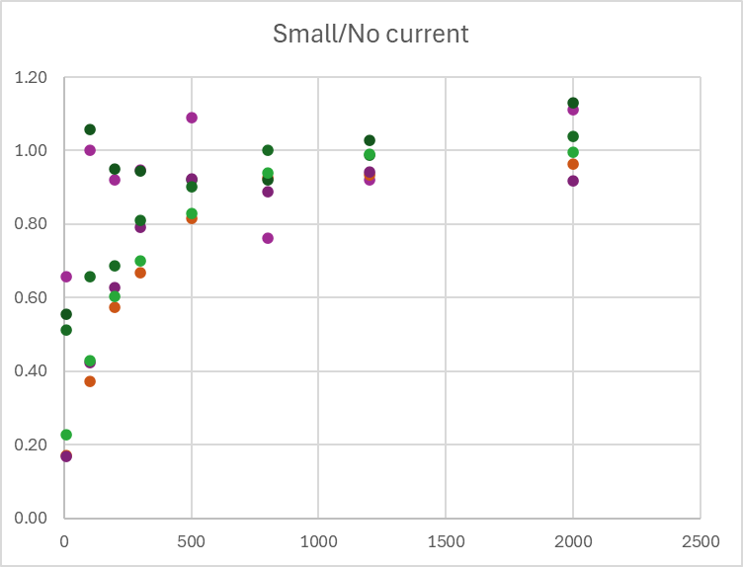
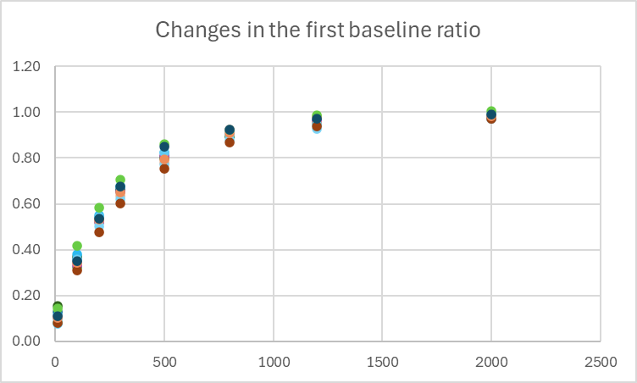
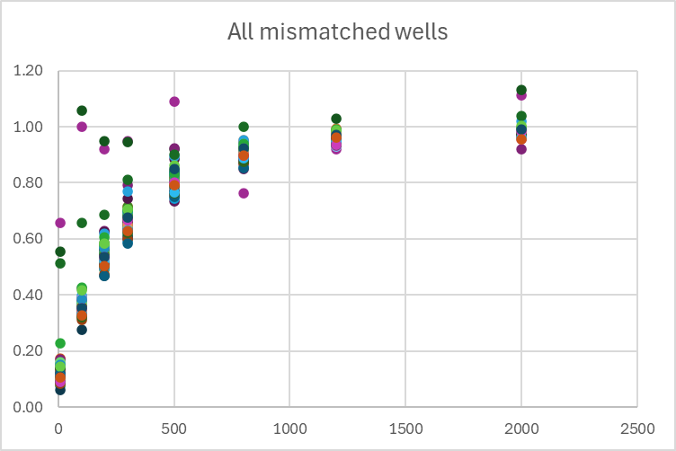
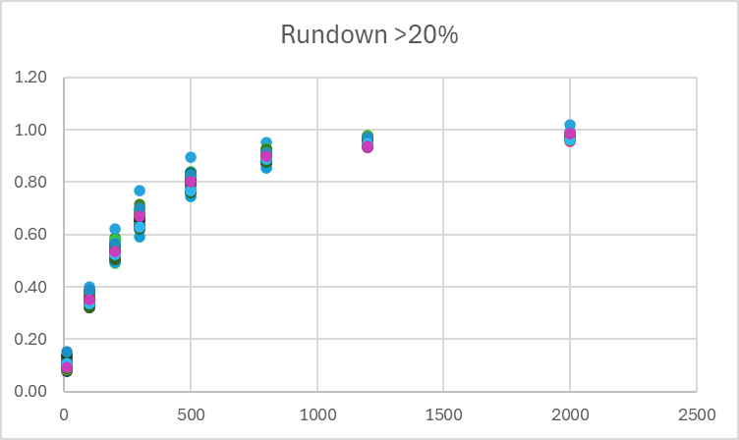
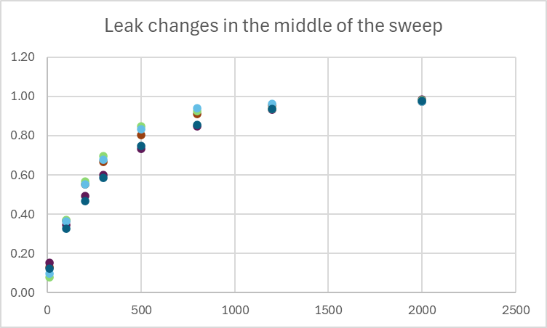
Understanding the mismatch between manual and autoQC for the “recovery” and its impact on the calculated parameter (recovery from inactivation time)
After further inspection of mismatched wells, there are different reasons for manual exclusion:
Changes in the first ratio baseline
Leak changes in the middle of the sweep
Rundown >20% in the first pulse amplitude
Small current/no current amplitude
Nothing obvious (not sure why it was discarded)
“Small/no current” and “rundown” seem to impact the calculation of the recovery time, both are easy to fix.

Slide 9
Summary and next steps
During this time, we have standardized the exporting format, incorporating valuable metadata associated with the exported wells. This metadata will be utilized later in the plotting and aggregation of experiments, including criteria such as compound name, concentration, and holding voltage.
Manual QC for the IV input files appears to be more stringent than the automatic QC process, particularly at -75 mV. This may be specific to this dataset, as previous validation of the process achieved over >85% of correctly assigned labels compared to manually curated data. Given that a second QC layer will be applied after calculating the biophysical parameters (point 3, slide 2), a ~20% mismatch at this stage is considered acceptable.
We will evaluate the impact of the mismatch in the parameters obtained from the IV files, depending on that we could propose changes or keep the QC as it is.
The strategy to leverage the QC process developed for the IV files and apply the same criteria to other file types was successful for tail protocols (at both holding voltages). However, the recovery file requires further improvement.
A detailed analysis of mismatch cases in recovery from inactivation shows that, for most manual exclusion criteria (slide 8), the impact on recovery time is marginal—except in cases of small/no current and rundown >20%.
Recommendations for Improving the Auto QC Process for the Recovery File:
Use the cursor C1 value to exclude cells with currents smaller than -300 pA. This criterion is more stringent than the one used for the IV protocol (-200 pA) due to the greater susceptibility of this protocol to rundown.
Introduce a new cursor ratio, C1 / C16, referred to as "Rundown." If Rundown > 1.2 or Rundown < 0.8, the well should be excluded ("F").

